Slide 1

Company Profile
TOPSTREAM GLOBAL SOLUTIONS LIMITED
HEAD OFFICE: #7, Woji Road, Rumuogba,
Port Harcourt, Rivers State
Telephone: +234-9150708682
E-Mail: info@topstreamglobal.com
Web : www.topstreamglobal.com
ENGINEERING | PROCUREMENT | CONSTRUCTION | FLOWLINE INSTALLATION & FACILITY MAINTENANCE | SURVEY|ENVIRONMENTAL & WATER ENGINEERING | ELECTRICAL & INSTRUMENTATION
www.topstreamglobal.com

Slide 2
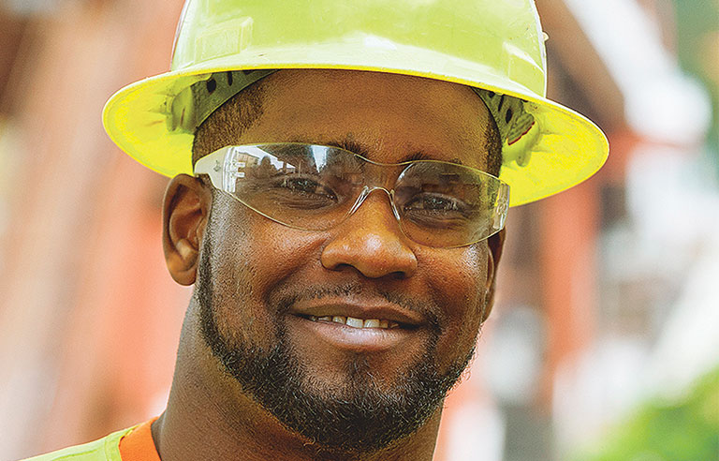
Who We Are
TOPSTREAM GLOBAL SOLUTIONS LIMITED (TGSL) is an exclusively Nigerian owned service company, primarily engaged in the provision of specialized Engineering, Construction, Procurement, Flowline Installation & Facility Maintenance Services, Survey works, Environmental & Water Engineering, Electrical & Instrumentation to the Oil and Gas, Government, Public & Private Industry in Nigeria.
Our expertise, technology and comprehensive solutions deliver certainty and added value to all of our projects.

Slide 3
Policy Statement
It is the policy of TOPSTREAM GLOBAL SOLUTIONS LIMITED to adopt strict measures in conducting its operations so as to ensure the safety of persons and properties and maintain a leadership role in our services with our numerous clients.
Do it the best and safest way
Vision Statement
Mission Statement
Be one of the most reputable and profitable indigenous energy Service Company participating effectively in the global industry. To be a leading and highly professional oil service company in our segment of the oil service industry in Nigeria that compares favorably with the best anywhere in the world.
To provide Total Quality Services (TQS) at a reasonable cost and within the shortest time, while sustaining a stable and expanding organization using the newest technology available globally and competent personnel as well as helping to develop

Slide 4
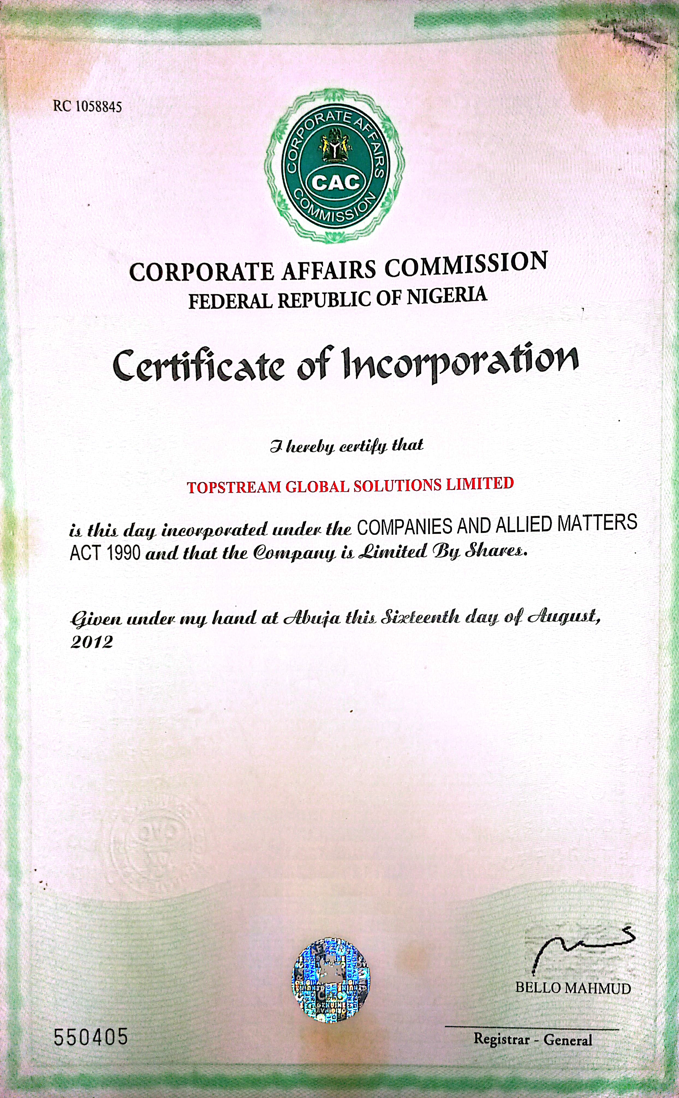

Slide 5
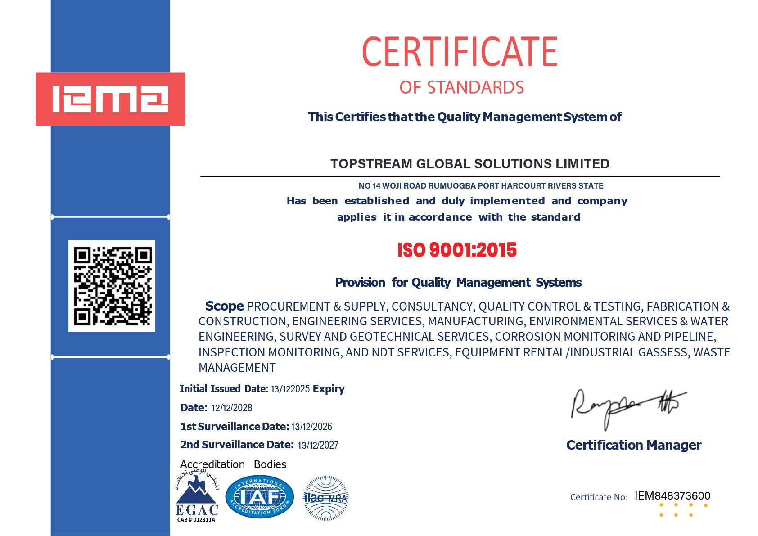

Slide 6
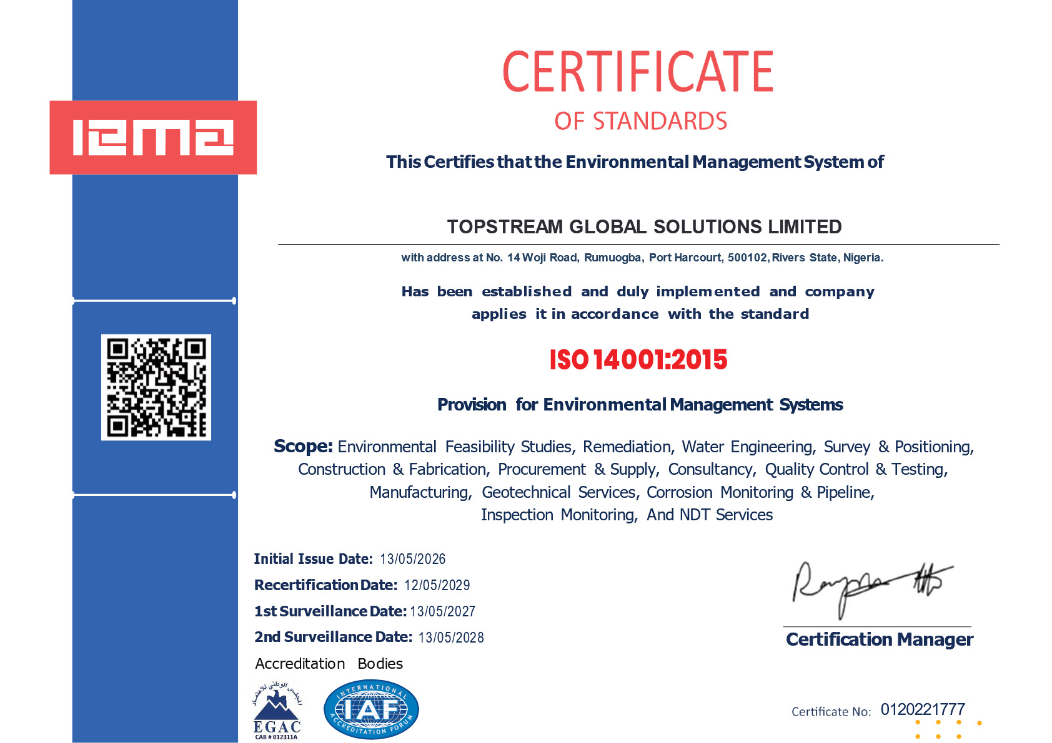

Slide 7
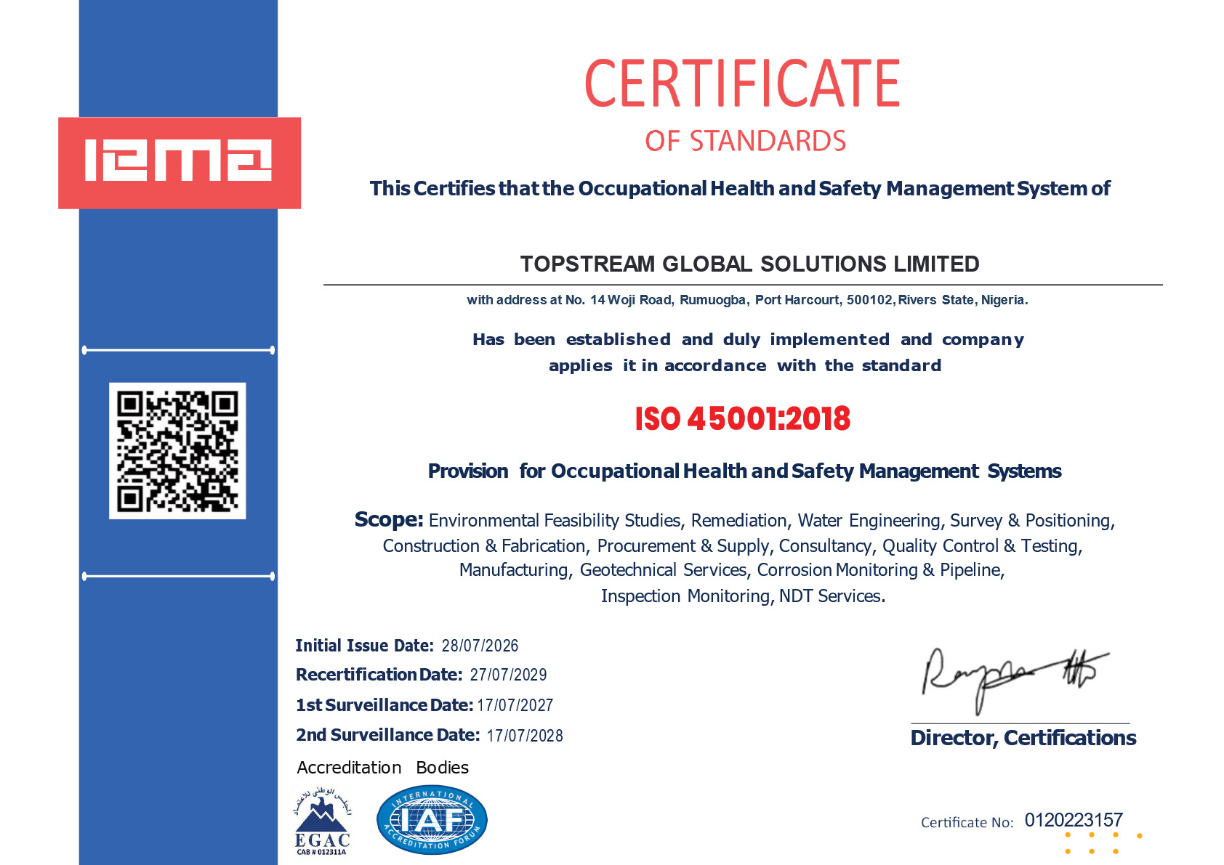

Slide 8
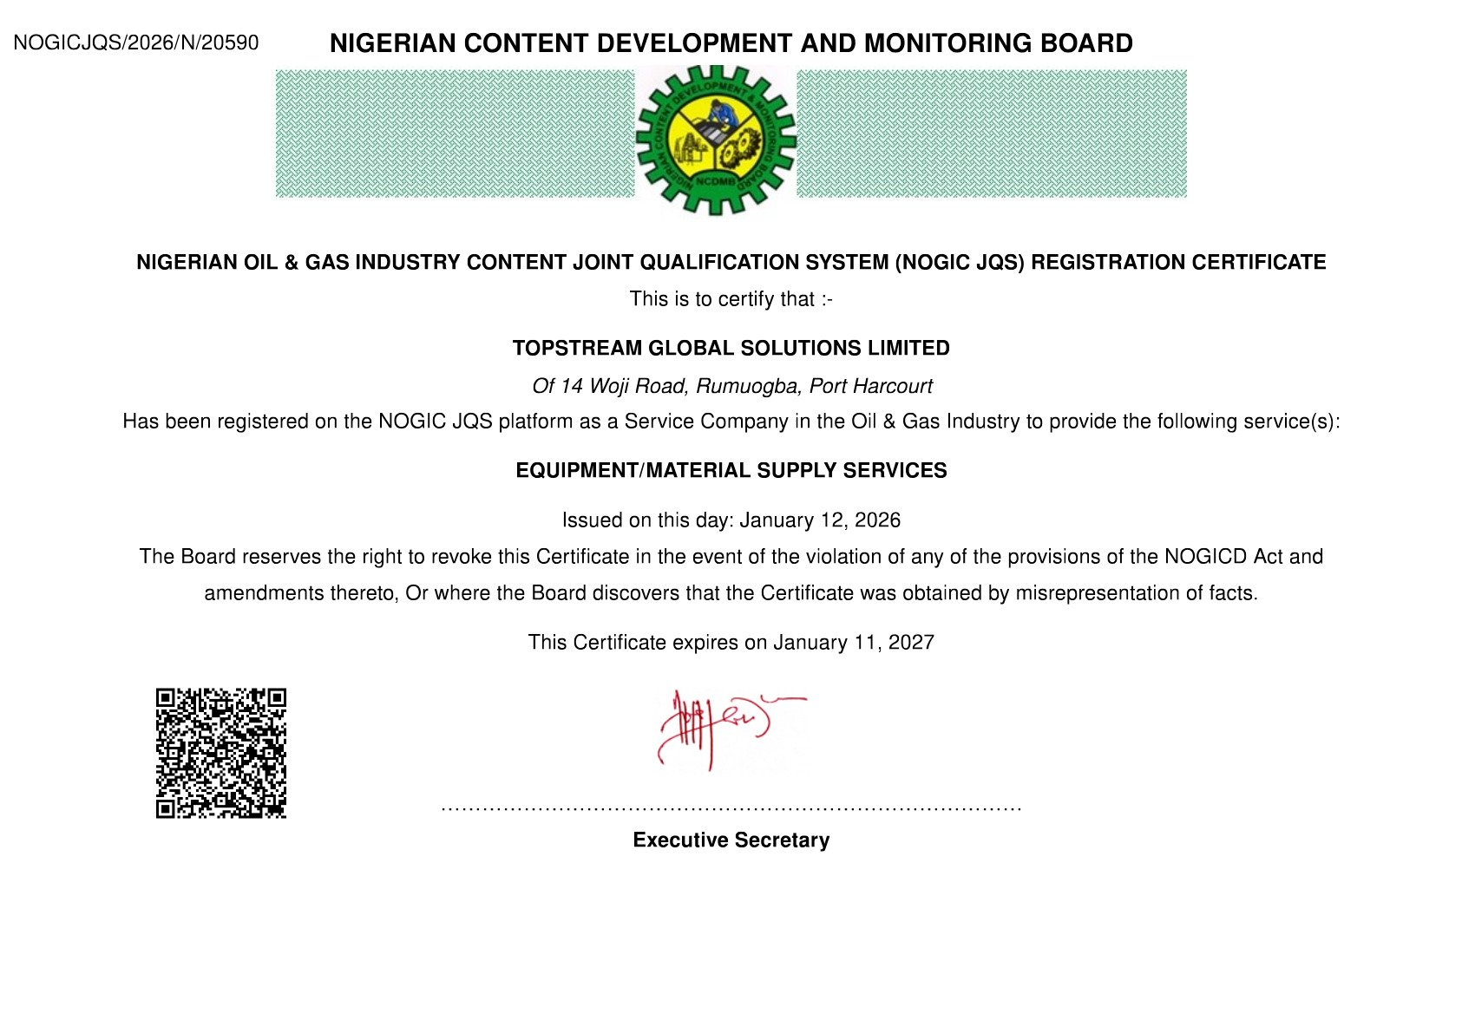

Slide 9
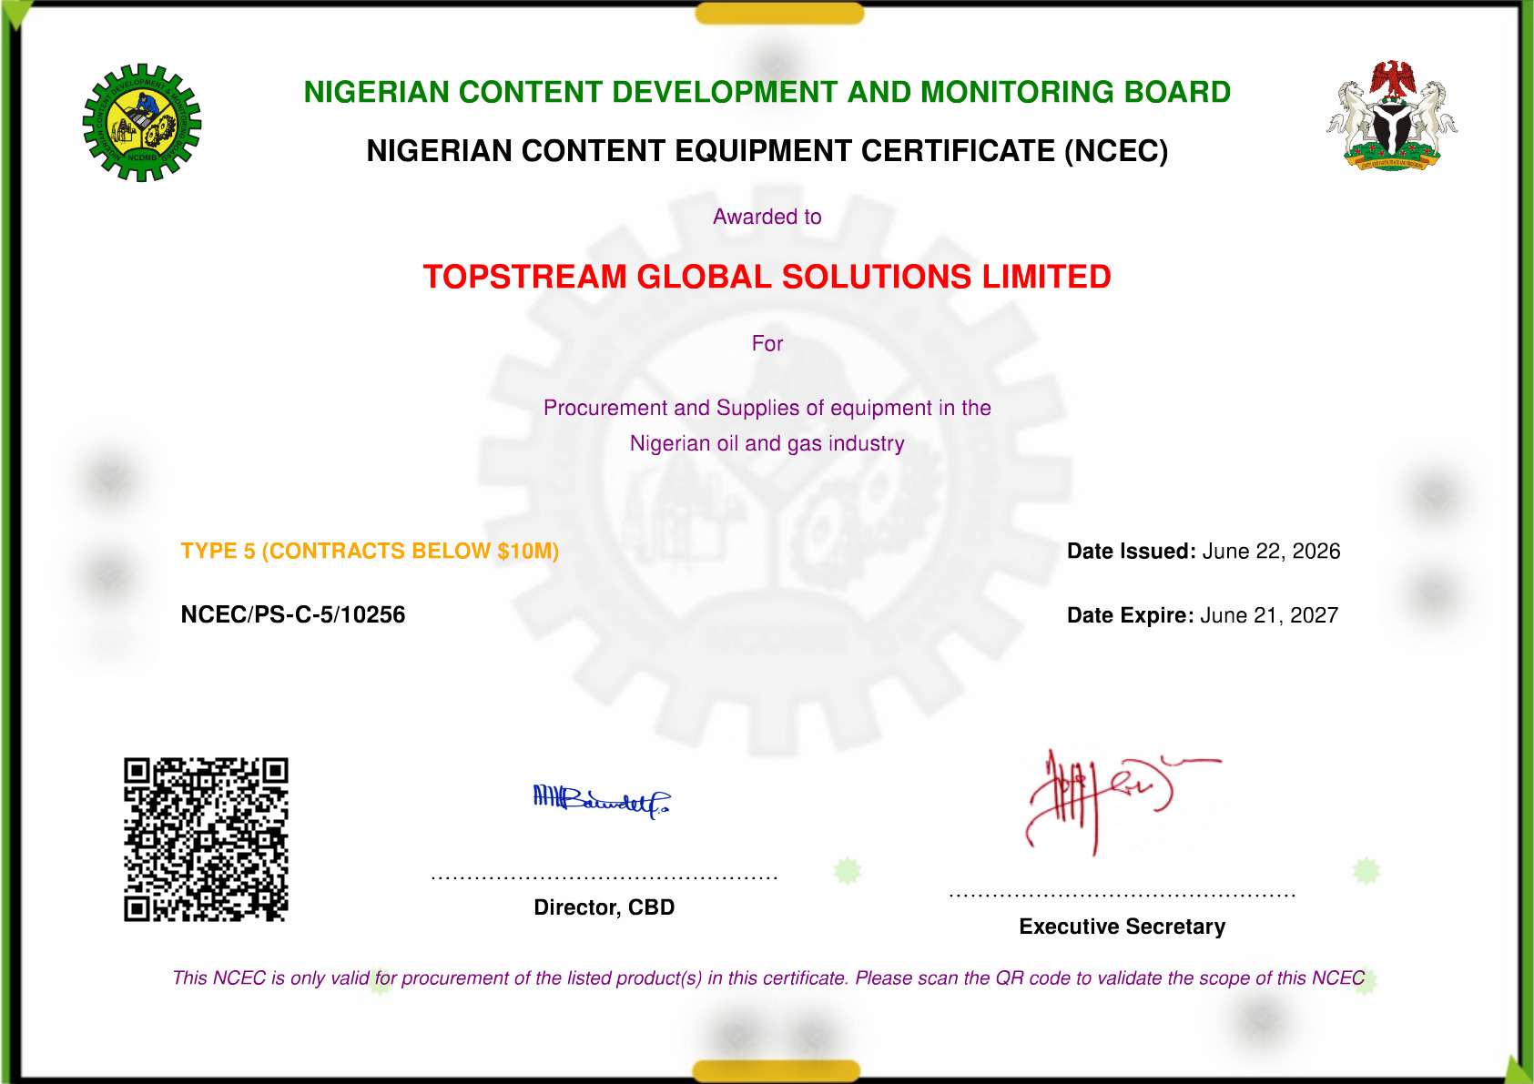

Slide 10
What We Do
We offer Professional Engineering, Procurement, Construction, Installation (EPCI) Services.
Engineering, Construction & Installation Solutions
Procurement Solutions
Engineering Construction Services
Process & Facilities Engineering
Water Engineering Services
Survey and Environmental Engineering
Asset Integrity & Fabrication Maintenance Services
Man Power Services
Procurement
Equipment Leasing
Asset Life Extension Services
Electrical & Instrumentation

Slide 11
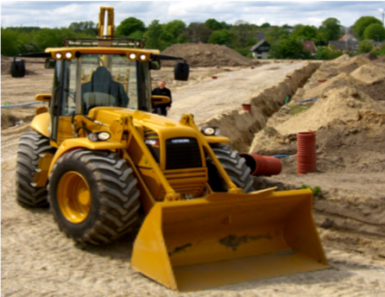
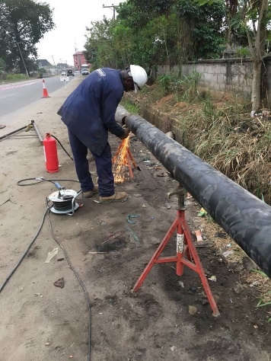
Engineering Construction Solutions
TOPSTREAM GLOBAL SOLUTIONS LIMITED offers in construction and mechanical management is a total concept of Engineering, Procurement, Installation and Commissioning (EPIC), and our team of Civil Engineers, Quantity Surveyors, Welders, Painters, Architects and Technicians can handle projects from design to execution.
We adhere to our principles of uncompromising quality and standards at
every stage of our activities and provide professional services to our client such as make them see that we are committed to quality and appreciable finishing and timely turn-in of the projects.
We have excellent expertise in every field that we explore into and with
people as diversified and these in terms of experience TGSL in indeed a
force to reckon with.
Our Engineering Construction Services span through the following:
Engineering designs, consultancy and supervision services
Facility, Drainage, Road, and Bridge Construction
Mechanical Fabrication
Pre-Cast Concrete Construction & Installation
Foundation Excavation Construction Testing
Piling Foundation Works

Slide 12
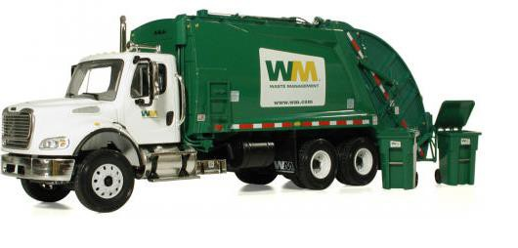
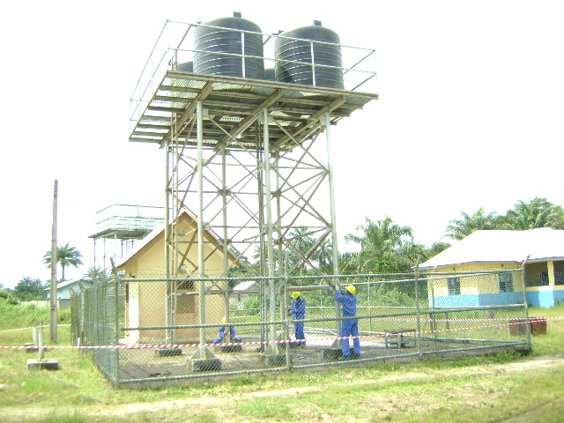
Environmental Study, Water Engineering & Management Solutions
TOPSTREAM GLOBAL SOLUTIONS LIMITED provides high quality water engineering and environmental services to our clients throughout Nigeria, particularly in Niger delta, with our experienced and qualified staff we have been designing and implementing practical solutions to meet clients' objectives for over 15 years. Our water engineering and environmental service ranges from:
Preliminary survey for ground water, engineering report and recommendations.
Soil remediation, spillage clean up & containment services.
Environmental Impact Assessment Study.
Borehole drilling, completion, Installation and Commissioning
Water distribution network, analysis and treatment system.
Expansion, upgrade & maintenance services
Underground water monitoring and flow direction study.

Slide 13
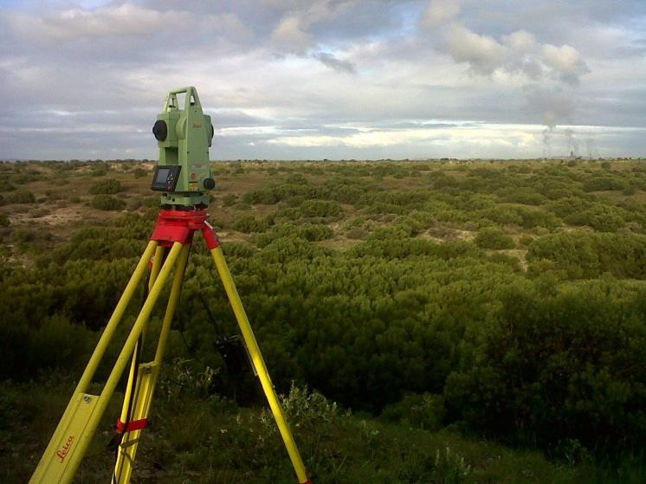
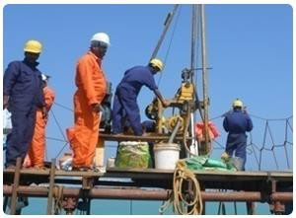
Survey and Geotechnical Investigation Solutions
TGSL undertakes a varied offshore/onshore survey and geotechnical service that achieves the desired goals of our reputable clients. Our operations are backed by the assistance and technical collaboration of reputable companies and consultants. We continually provide accurate and economical measurements and interpretations from soil and water together with creative solutions to clients’ problems.
We offer the following services:
Topographic Survey
Positioning Engineering Services for Pipe Lay/Construction/Installation Barges, Rigs, DVS, Tug Management System, and others.
Hydrographic/Geophysical Survey Services
Site Investigation
Soil stabilization
In-situ soil stress measurement
Design
Sand Search

Slide 14
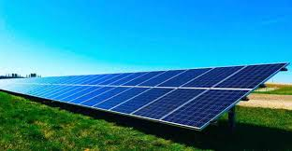
Electrical & Instrumentation Engineering Solutions
ELECTRICAL
You can rely on us for all your electrical works including engineering design loop check, cable trays, termination, glanding, solar panel installations, supervisions, and repairs.
TRANSMITTERS
Call us for all your transmitters projects requirements including engineering designs, installations, calibrations, loop check and repairs.
EXPERIENCED PERSONNEL
Our personnel experience, skills and dedications is our asset and strength in this field of Electrical, Instrumentation and Control Engineering.
This is the reason why we don’t play with anything that has to do with our personnel welfare so that they can serve our clients the best way they can.
You can trust for the best project execution and deliveries when you call us for all your electrical , instrumentations and control requirements

Slide 15
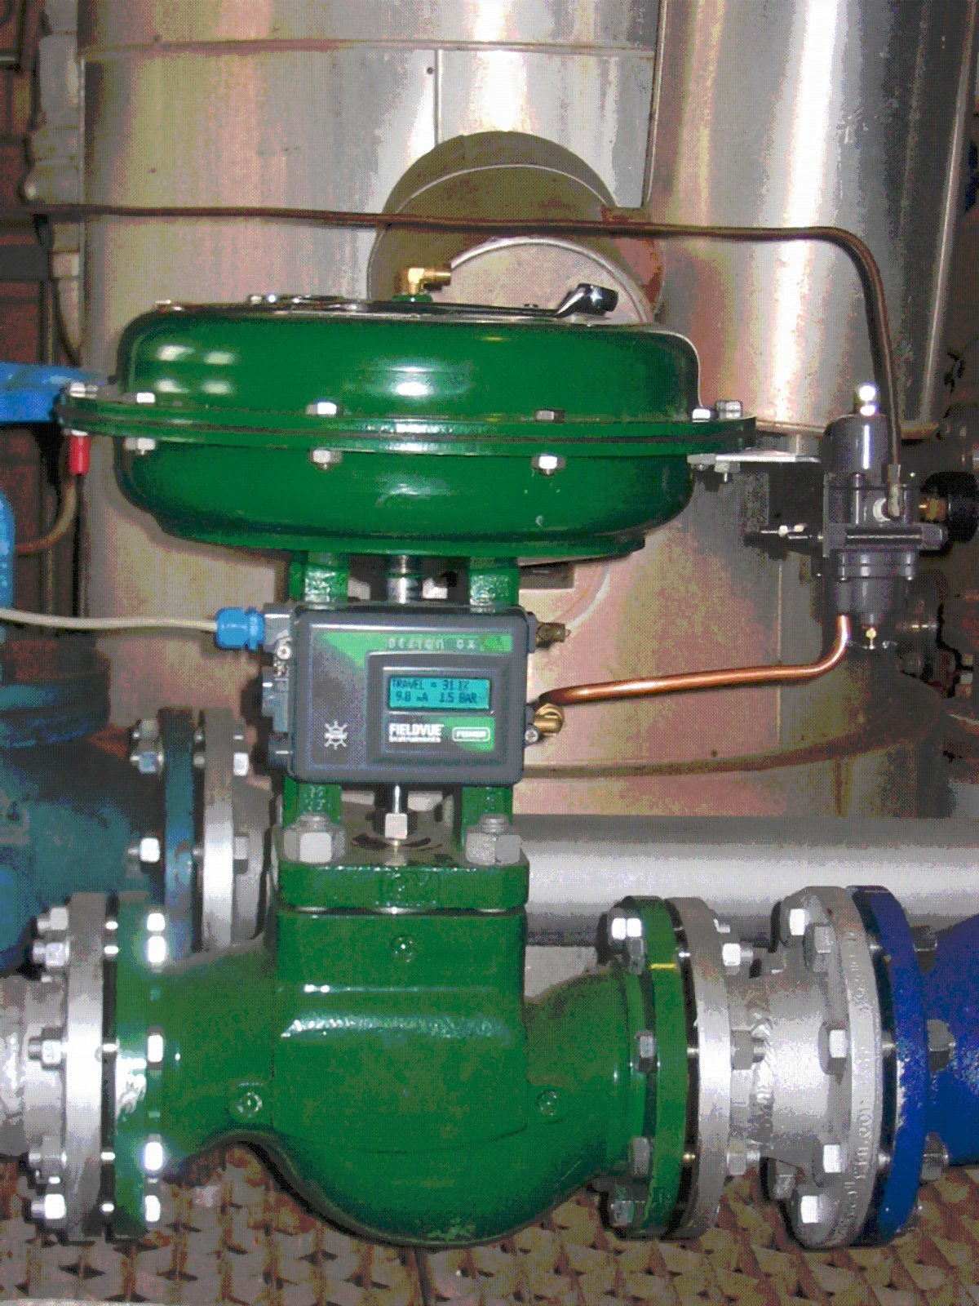
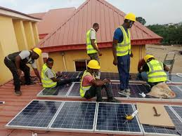
Electrical & Instrumentation Engineering Contd.
REPAIRS:
  Repairs to the ASME and API standards
  Installation of Solar Panels
  Well trained staff
  Experienced Staff
  Provide best equipment
  Make as new always
SELL:
  Take away all your headaches for sourcing
  We Represent good OEM for Solar Panels, etc
  Provide technical support to ensure right selection
  Fast delivery
  After sales support

Slide 16
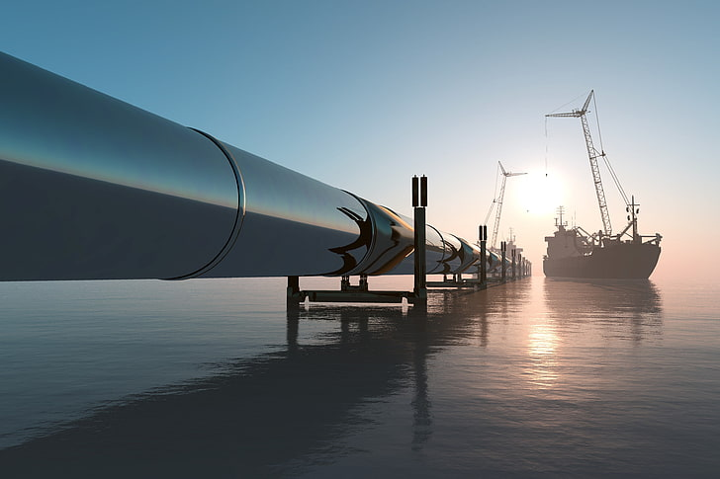
Pipeline & Subsea Engineering Solutions
Our pipeline and subsea engineering team is made up of very experienced personnel with many years of deep water experience.
TOPSTREAM’s strategic alliances with our international partners, allows us to engage cutting edge technology in delivering deep water engineering solutions which minimizes downtime, increases production and ensures that Client’s operations are successful.

Slide 17
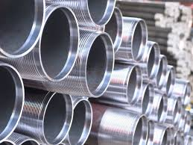
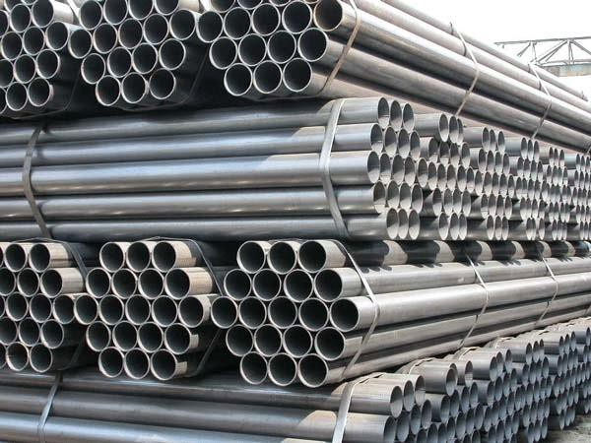
Pipeline Procurement Solutions
TOPSTREAM GLOBAL SOLUTIONS LIMITED is extensively involved in the procurement of process, instrumentation and automation equipment, mechanical and piping products/components for the oil and gas industry and general procurement services.
Leveraging on our good business relationships with our foreign partners and robust financial base, we have the capacity to deliver our services for medium sized and mega oil and gas facilities.
Please find below more sales/services we render.
Steel Valves and Fittings
Line pipes
Steel Plates and Grating
Safety Wares and Equipment
Corrosion Materials/Equipment
Casing and Tubing (OCTG).
Drilling Pipes and Drill Collars.
Drill Pipes Handling tools (Slips Elevators, Safety

Slide 18

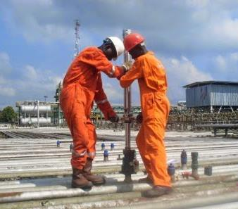
Process and Facilities Engineering Solutions
Our Process and Facilities Engineering team have worked on all phases of a typical project life cycle – Pre-FEED, FEED, Detailed Engineering and Production / Operations Support.
Our solutions include, but not limited to:
Process & Facilities Engineering (Pre-FEED, FEED, DED)
Early Production facility (EPF)
Piping / Layout
Process Design Review / Process Optimization
Project Management
HAZOP, HAZID, SIL & LOPA Studies
Technical Due Diligence
Technical Safety

Slide 19
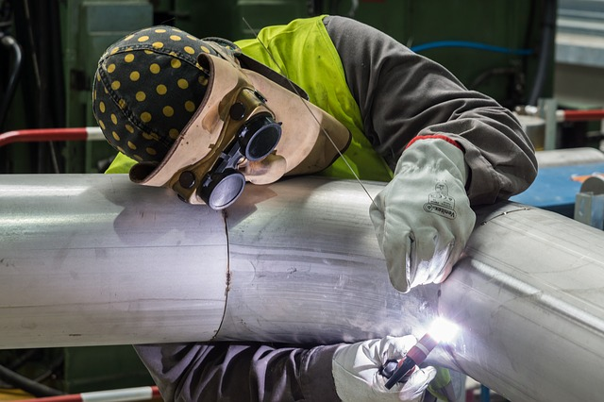
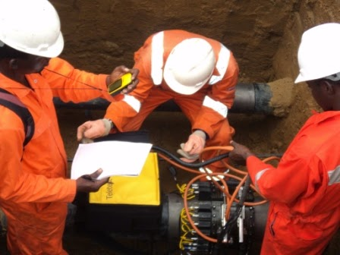
Asset Integrity & Fabrication Maintenance Solutions
Improving the performance of assets is key in any facility and this can be achieved by the implementation of an optimum asset integrity management process.
TOPSTREAM GLOBAL SOLUTIONS helps its clients to optimize the viability of its assets by moving from a reactive to a proactive based integrity and reliability management thereby increasing revenue.
Our solutions include:
Fabrication Maintenance Services
Coating Services
Operating and Maintenance Review
Inspection Services
Material Selection & Corrosion assessment

Slide 20

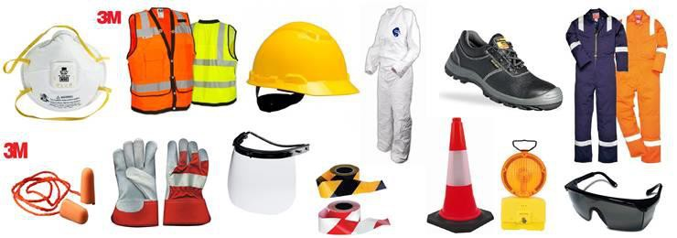
Procurement Solutions
We provide Industrial Equipment, Spare Parts in partnership with Original Equipment Manufacturers and Technical Partners for both one off order supplies and price agreement long term supplies, all following an integrated approach to procurement servicing.
Our technical teams are involved from the early equipment specification to provide preliminary cost estimates for early RFQ to vendor.
Also, our commercial and logistics teams play a key role to guarantee a hitch-free procurement process from Tender, Factory Acceptance Testing, Transportation & Installation, Commissioning & Start-up and Handover.

Slide 21
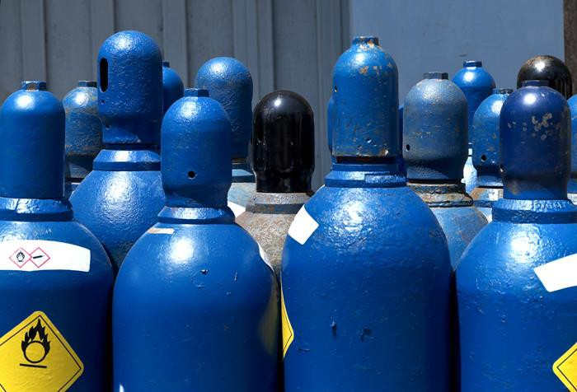
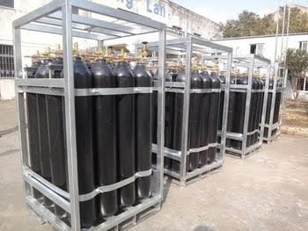
Procurement & Supply of Chemicals & Industrial Gases
At Topstream Global Solutions Limited, we supply the following chemicals and industrial gases:
Paints
Nitrogen
Oxygen
Acetylene
Argon
CO2
Refrigerants
Propane
Gas Mixtures

Slide 22

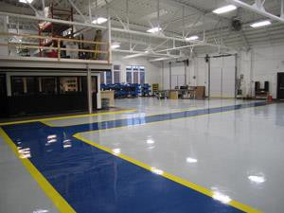
Asset Life Extension Solutions
We offer a range of Facility Maintenance and Facility Life Extension Services, cutting across maintenance of Platform and Wellheads, Reliability, Availability & Maintainability (RAM) Studies, Fault-Tree Analysis and Reliability Based Maintenance.
Our solutions include:
Reliability, Availability & Maintainability Studies
Operating and Maintenance Review
Fault-Tree Analysis
Testing & NDT

Slide 23
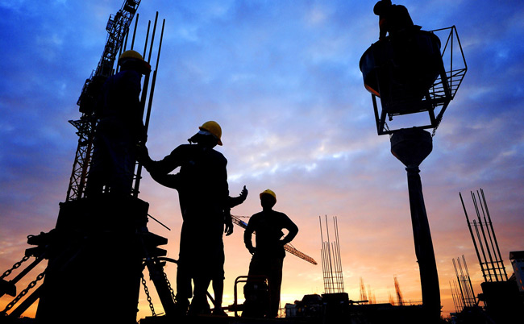
Manpower Solutions
We are a trusted Manpower Servicing Company, providing word-class recruitment and manpower management services to the Nigerian Oil and Gas Industry.
Our experience and well-trained professional team has a clear understanding of Manpower recruitment, training and development.
We support our clients with highly competent technical personnel, who go through a rigorous selection and vetting process and are available for either short or long-term placements.

Slide 24
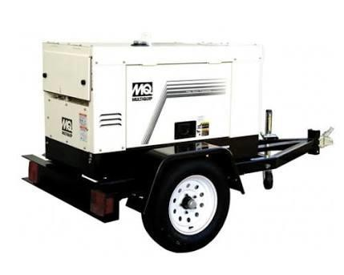
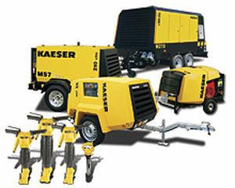
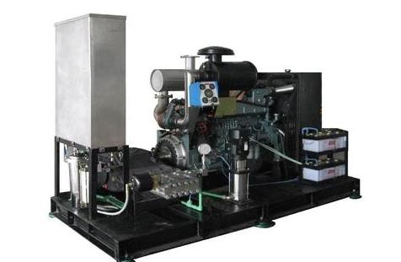
Equipment Leasing Solutions
We own an array of quality industrial equipment required for various Oil and Gas operations.
Our Equipment meet industry standards and carry all necessary quality and safety certifications.
They include, but not limited to:
Cranes
Excavators
Bulldozers
Barges
House Boats
Tugboats
Trucks
Compressors
Welding Machines

Slide 25
Maintenance Plan & Policy
Safe Maintenance Plan have be put in place with the use of safe and practice maintenance procedure such as LOTO procedure. LOTO (Lockout Tag out) is a procedure that is aimed at saving lives of worker who must work in industrial facilities. The procedure would be aimed at ensuring that physical locks are made available for use on equipment that have the tendency to energize themselves. Also tags would be made available, such as “DO NOT OPERATE” signs to be place on plant or equipment that is faulty or is currently undergoing various forms of maintenance activities. The above mentioned procedure is aimed at achieving zero accident performance in our various worksites. Maintenance record would be provided and a data base created so as to enhance periodic maintenance. All other safe engineering control measure will be put in place during maintenance.
Same procedure applies to maintenance of pumps and other equipment.
Signed
Management

Slide 26
Health and Safety
The primary objective in every project is to provide a risk free working environment for worker and clients representatives. That’s why Topstream follows strict procedures in implementing HSE rules
Quality Control Management
Community Relations
TOPSTREAM GLOBAL SOLUTIONS Quality Control Management plan was designed with objectives ensuring the Client’s satisfaction with quality of both work achieved in the construction stage and with the finished product. Each project, regardless of size, has a dedicated quality team to assess everything from the materials used to the method of construction to site cleanliness.
Building partnerships for sustainable development is part of our company’s corporate philosophy over the years, TOPSTREAM GLOBAL SOLUTIONS has seen itself as part of the people and environment in which it operated by identifying positively with their economical social and cultural needs and aspirations.

Slide 27
Health and Safety Policy
The Management of TOPSTREAM GLOBAL SOLUTIONS LIMITED ranks supreme the safety of its personnel, the client personnel and any other person who may be directly or indirectly involved in its operations.
The Management recognises that a safe work place is a combination of several factors involving the interplay of personnel, material, and equipment. Based upon this recognition, the Management shall ensure:
That suitable and adequate personnel, material and equipment is available for its operations.
That staff receive adequate safety training.
That safety meeting, including toolbox talks is held regularly on all sites.
That safety audits are regularly conducted to ensure compliance to safety standards, rules and regulations.
TGSL Management shall demonstrate these in all her operations and shall be responsible for a safe work place, free from foreseeable risks and hazards. TGSL believes that accidents are caused and, therefore, can be prevented.
Employee Safety Performance will be a major consideration in decisions affecting promotions, salary, and continued employment. Safety is the responsibility of every employee.
Signed
Management

Slide 28
Quality Policy Statement
It is the policy of TOPSTREAM GLOBAL SOLUTIONS LIMITED to provide products and services which comply with contract specification.
It is the management’s intent and commitment to ensure a planned and organized quality system which can demonstrate execution of those products and service in accordance with ISO 9001 series and other equivalent international standards. We aim to meet or exceed customer’s requirement for performance, time scale, quality, competitive cost and service and we are committed to on-going improvement of our products and services by a process of employed participation and teamwork.
In order to achieve these quality objective the company places importance on the tracing and eradication of causes of error with emphasis on prevention thus achieving high quality and improved efficiency.
The Quality Manager has the responsibility of coordinating and implementing the Company’s Quality System: identifying quality related problems and recommending corrective actions to eliminate non-compliance.
Signed
Management

Slide 29
Key Project Personnel
S/NO | DESIGNATION | NAMES
1 | Project Director | Daniel Michael Segun
2 | Project Manager | Engr. Felix Emesaha (COREN)
3 | Construction Manager | Engr. Jonah Nule (COREN)
4 | QHSE Advisor | Charles Ifiok (OSHA & NEBOSH)
5 | Operations Manager | Engr. Will Beresibo (COREN)
6 | Business Dev. Manager | Austine Omatseye
7 | Procurement Manager | Adedayo Mustapha
8 | Project Engineer (Mechanical) | Samuel Chima

Slide 30
PROJECT EQUIPMENT
List of Engineering Construction Equipment
S/No | TYPE OF EQUIPMENT | QUANTITY
1 2 3 4 5 6 7 8 9 10 11 12 13 14 15 16 17 18 19 20 21 22 23 | Tipper Truck (10t) Motorized Water tanker Vibrator Haulage Truck Jack Hammers Concrete Mixer Concrete Pump Wheel Barrow Shovels Head pans Pay loaders Toyota Hilux Pick-up Pajero Four Runner SUV Iron Bending Machine Arc Saw Frame and Blades Bar Benders Wooden Planes Wooden Saw Carpentry Hammers Pincers Welding Machine Dumpers and Dumping trucks Block Moulding Machine | 3 4 20 5 4 10 12 15 Many Many 2 sets 5 1 4 Many 5 5 Many Many Boxes 4 2 4

Slide 31
PROJECT EQUIPMENT
List of Mechanical/Fabrication Equipment
S/NO | TYPE OF PLANT AND EQUIPMENT | QUANTITY
1 2 3 4 5 6 7 | Welding Machine Lincoln start and weld machine Denyo start and weld machine Electric welding machine Filling Machine Visa filling machine Black and Decker filling machine Drilling Machine Black and Decker drilling machine Drilling bits of all sizes Jacking machine Tripod mounted chain lift Tifor jack and sling wire Corrugating machine Folding machine Spraying machine Diesel engine spraying machine Electric spraying machine Annually operated spray machine Saw machine Saw frame Saw blade of various sizes /types | 1 1 2 2 2 2 2 sets 1 2 sets 1 1 1 1 3 Many

Slide 32
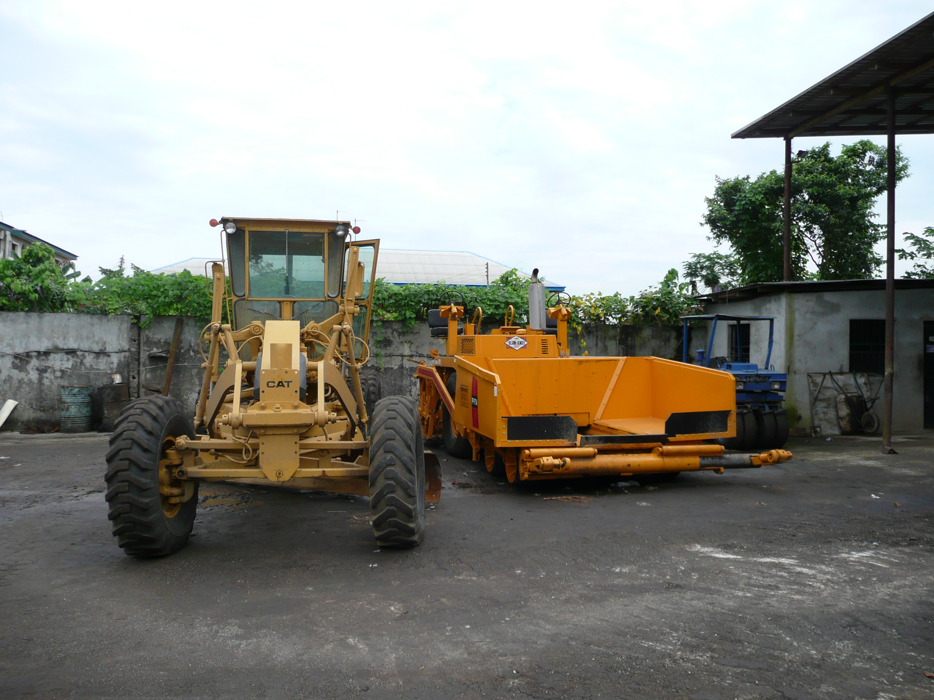
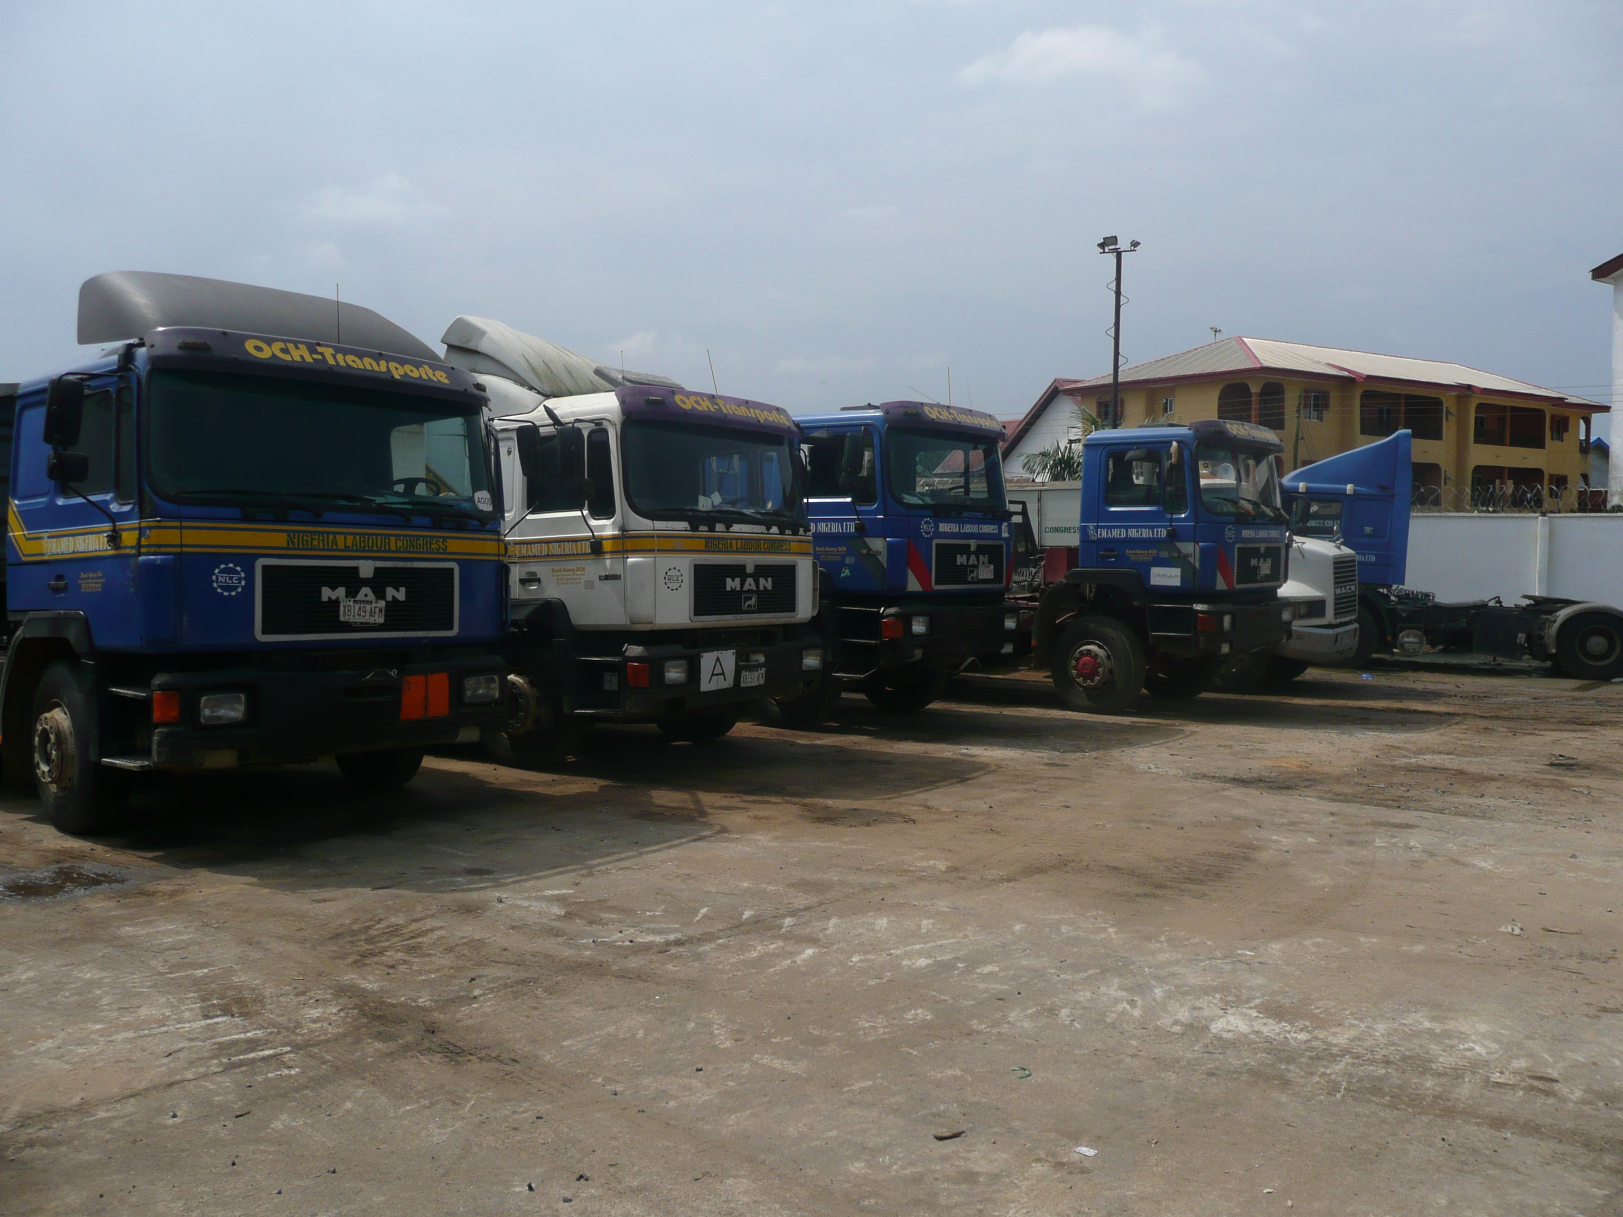
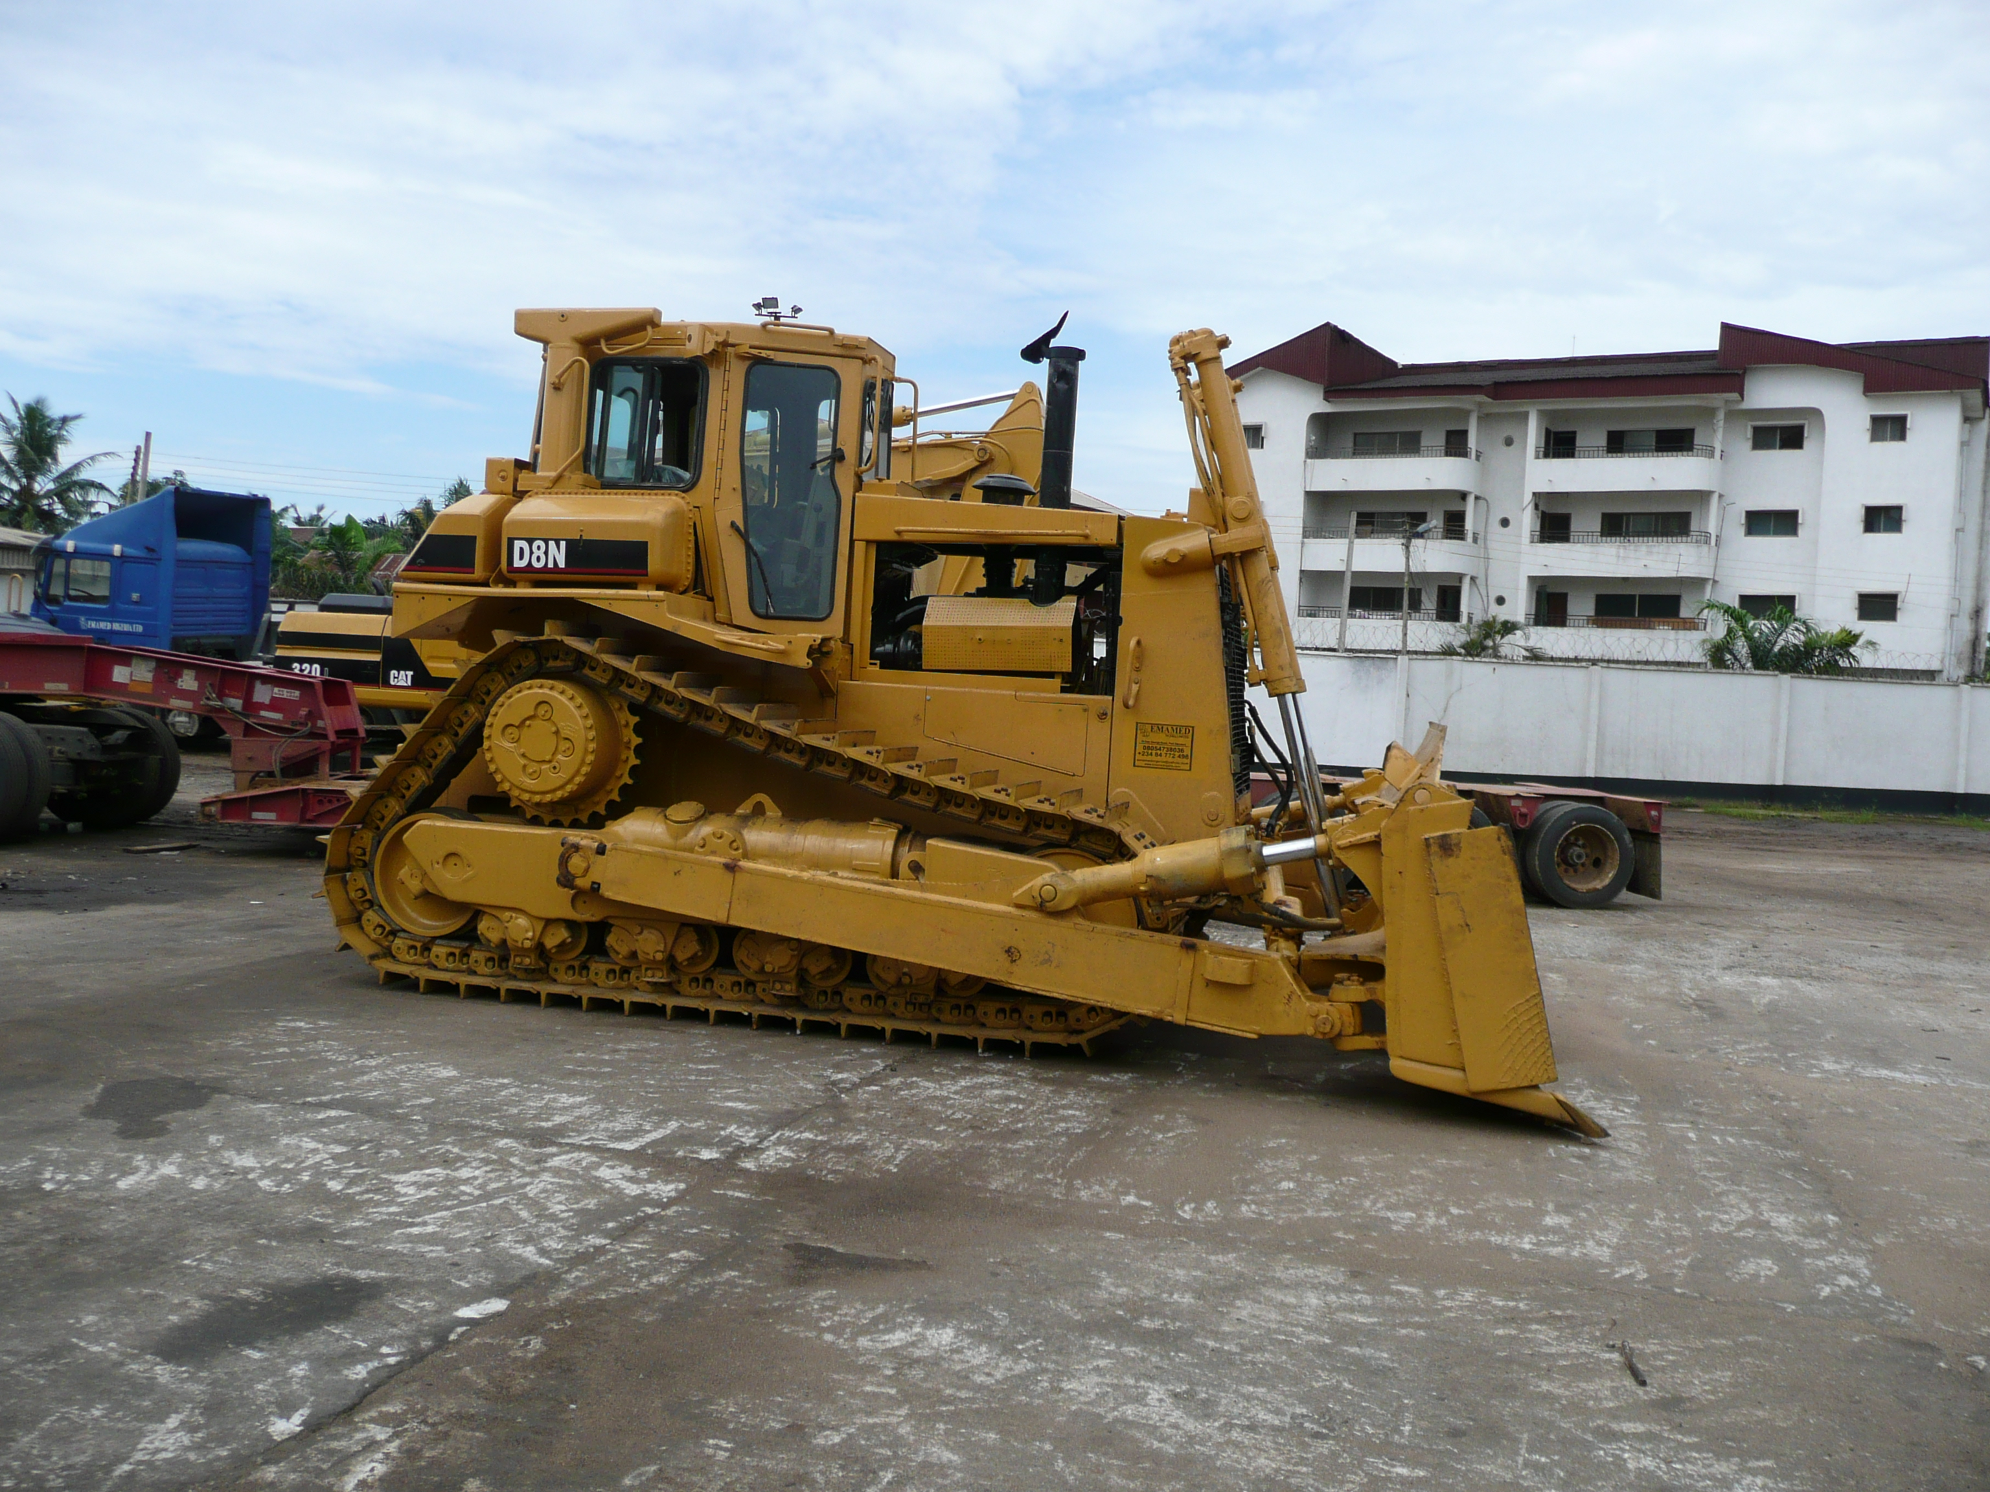
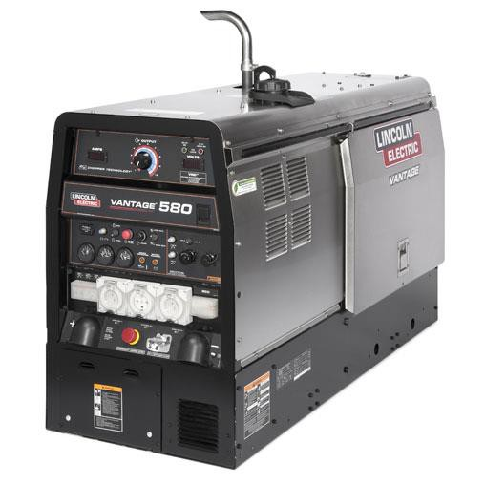
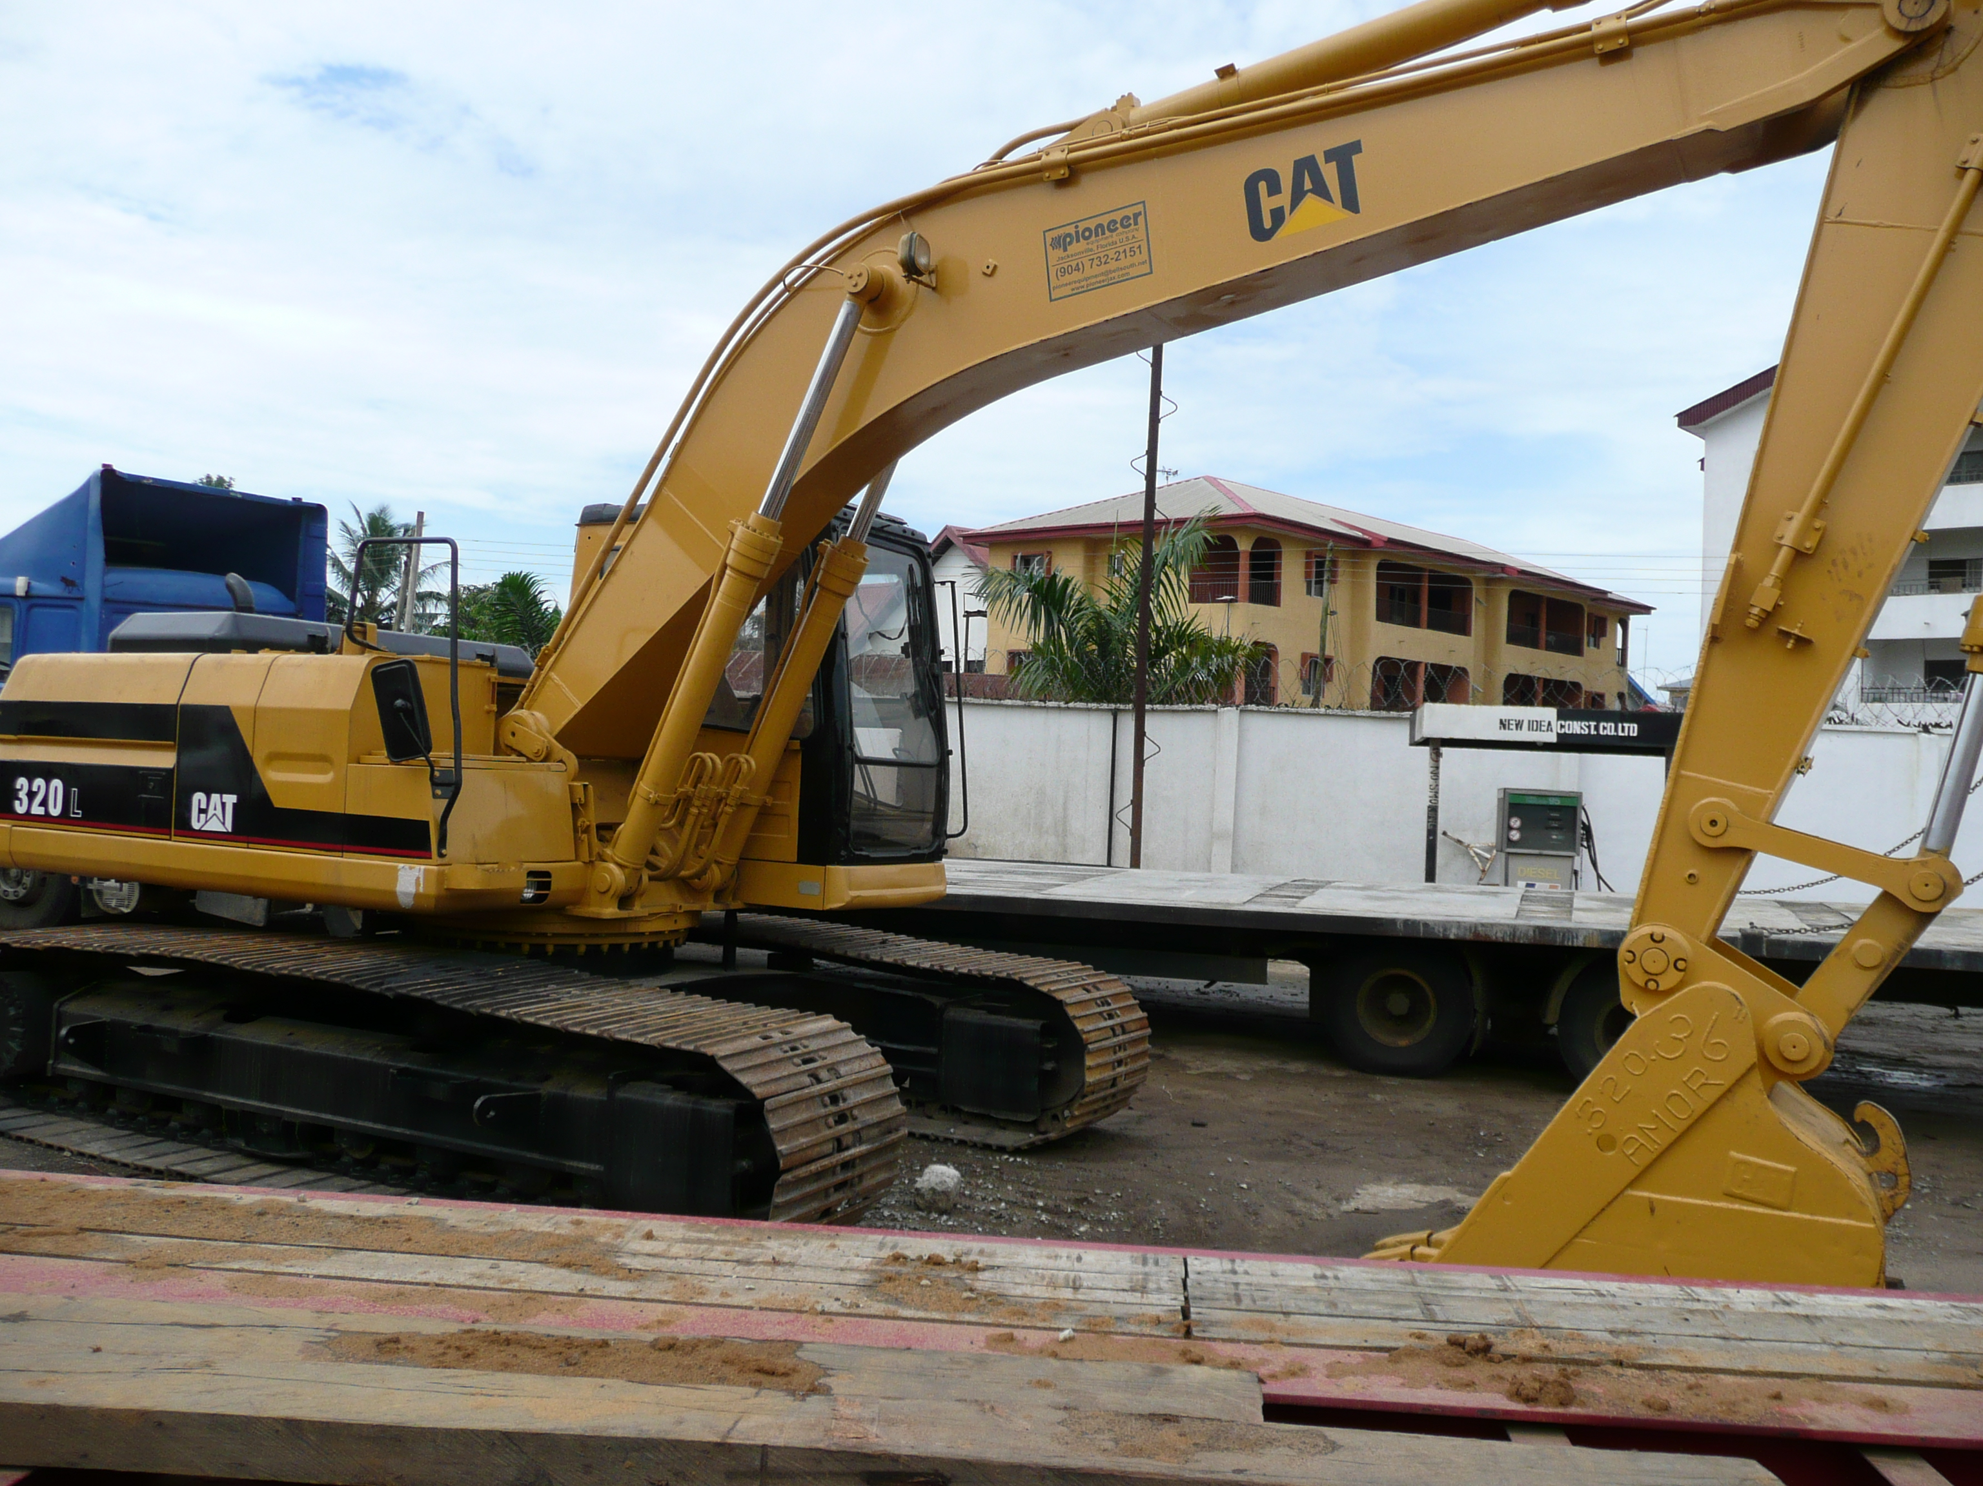
EQUIPMENT GALLERY

Slide 33
EXECUTED PROJECTS
S/N | PROJECT | DATE | CLIENT | STATUS
1 | PROCUREMENT & SUPPLY OF MECHANICAL FABRICATION MATERIALS. | 2025 | Nembe Crude Oil Export Terminal Limited | COMPLETED
2 | PROCUREMENT & SUPPLY OF SCAFFOLDING MATERIALS. | 2025 | Nembe Crude Oil Export Terminal Limited | COMPLETED
3 | SUPPLY OF 90,000 LTRS OF PREMIUM MOTOR SPIRIT (PMS) TO SPDC SOKU GAS PLANT . | 2023 | SUB-CONTRACT FROM BISTEIM INTEGRATED SERVICES LIMITED | COMPLETED
4 | PROVISION OF MECHANICAL TURN AROUND WORKS FOR EROTON EXPLORATION & PRODUCTION LIMITED AT ALAKIRI FLOWSTATION. | 2019 | SUB-CONTRACT FROM GELO INTEGRATED SERVICES NIG. LTD | COMPLETED
5 | FABRICATION & MECHANICAL CONSTRUCTION OF 5,000 GALLONS STORAGE TANK IN BRASS LOCATION | 2018 | NIGERIAN AGIP OIL COMPANY, SUB-CONTRACT FROM GEOVILLE CONSULTING LIMITED | COMPLETED
6 | CONSTRUCTION OF 9.2M HIGH STEEL TOWER & INSTALLATION OF STORAGE TANKS AT OBAMA FLOWSTATION | 2018 | NIGERIAN AGIP OIL COMPANY, SUB-CONTRACT FROM GEOVILLE CONSULTING LIMITED | COMPLETED

Slide 34
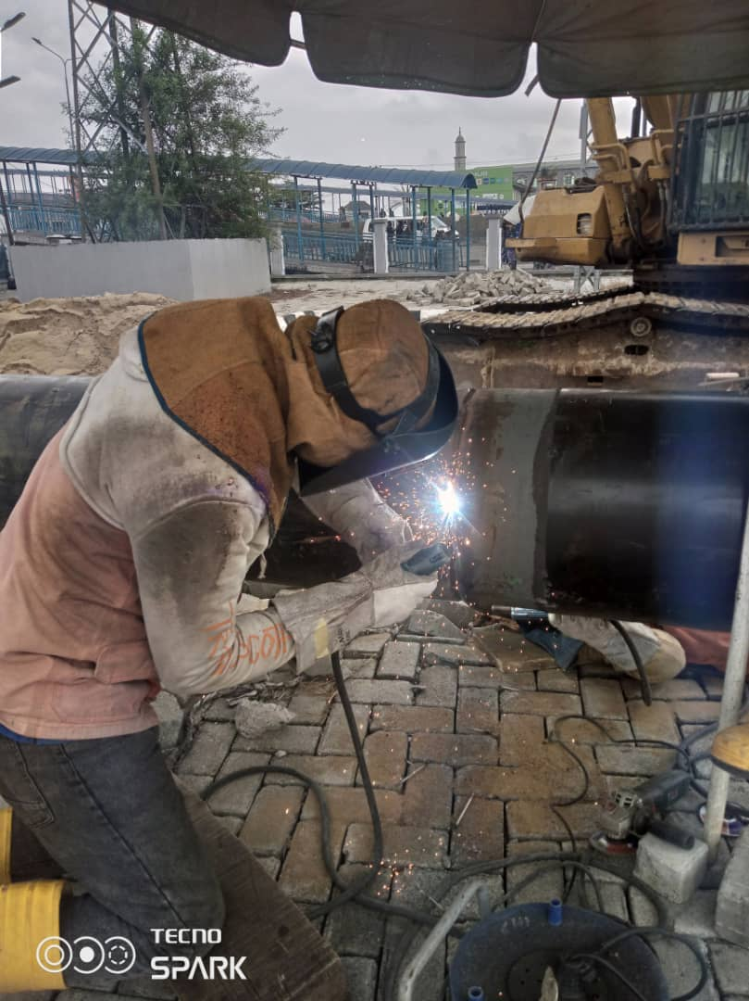
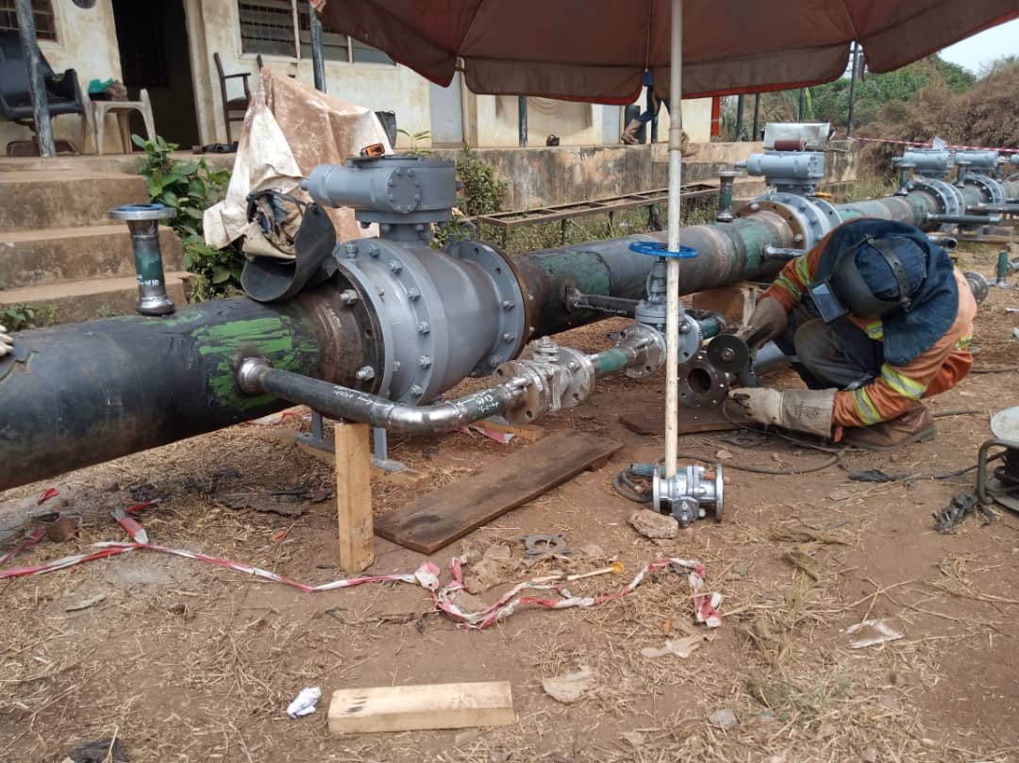
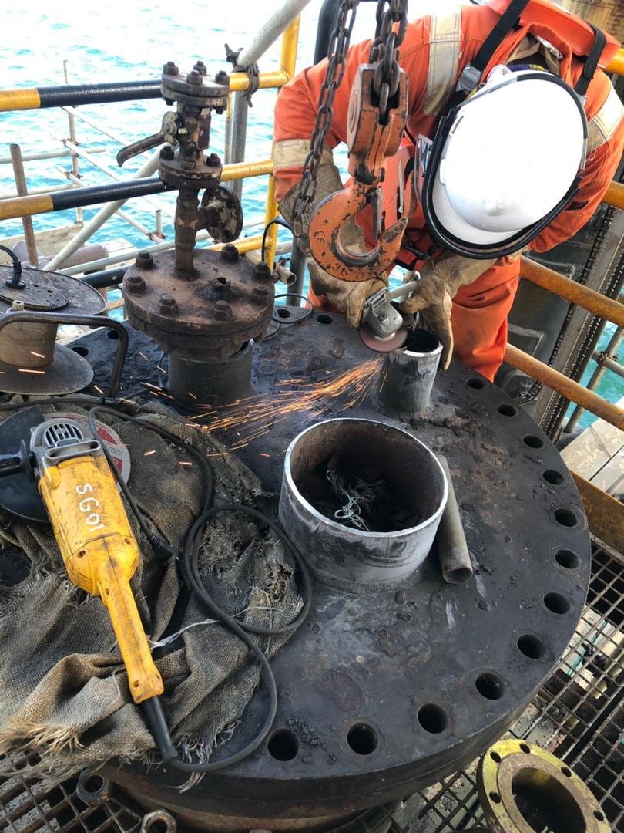
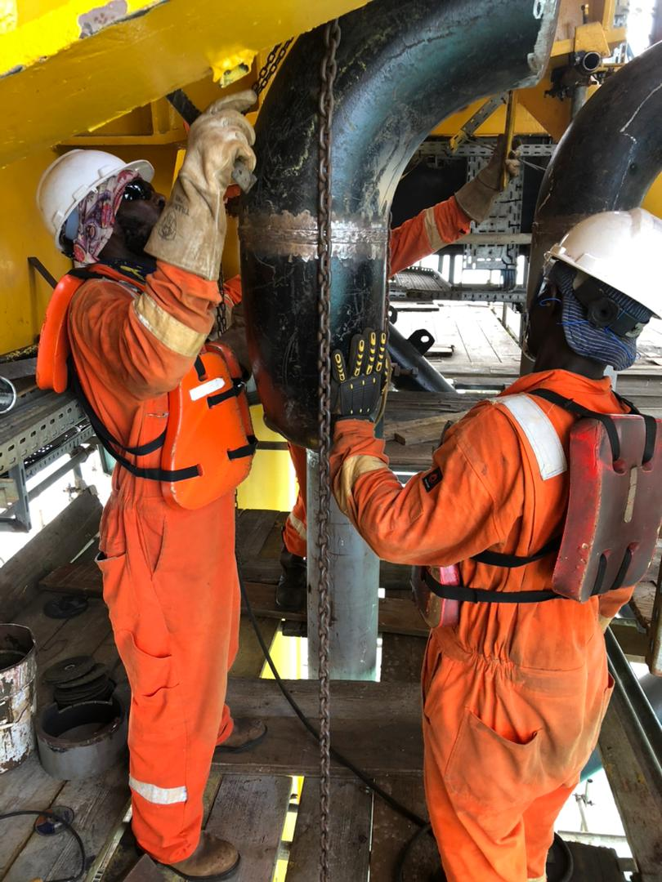
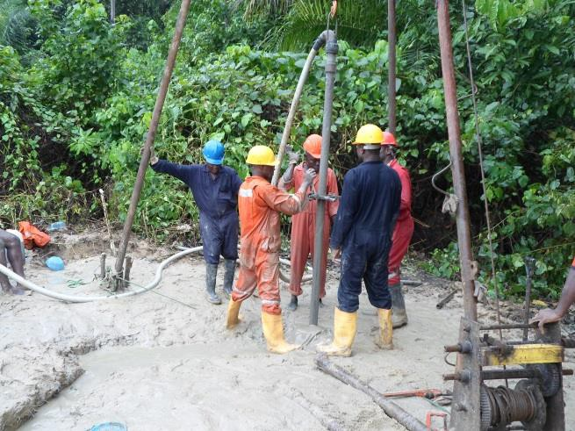
PROJECTS GALLERY

Slide 35
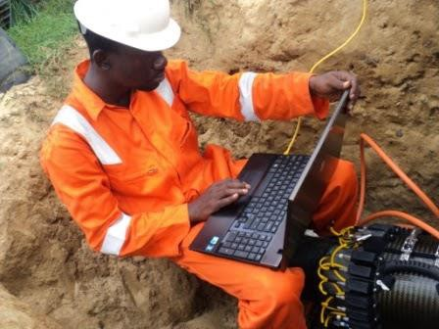
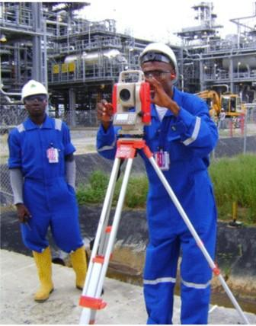
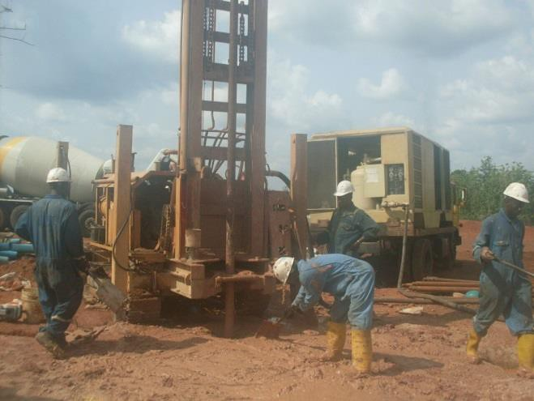
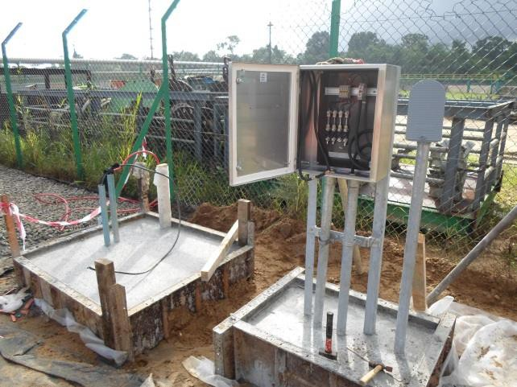
PROJECTS GALLERY CONTD.

Slide 36
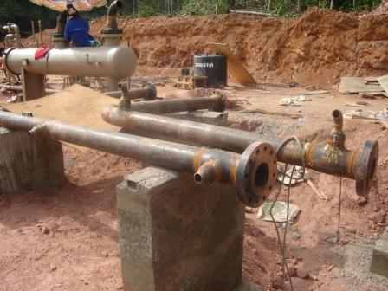
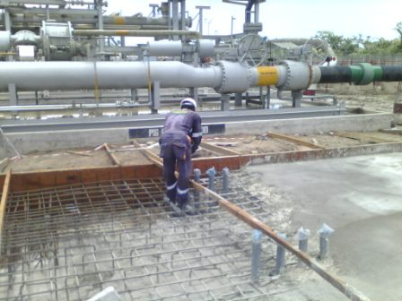
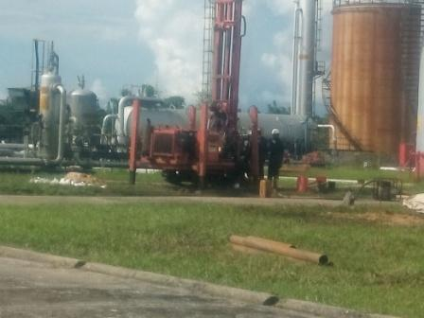
PROJECTS GALLERY CONTD.

Slide 37
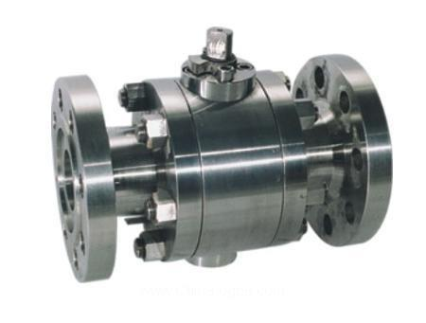
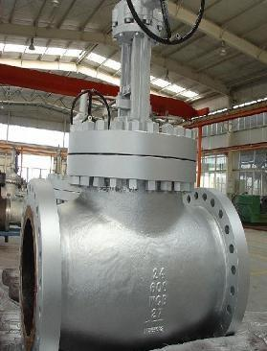
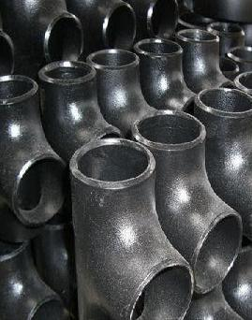



SUPPLY/PROCURED ITEMS
Ball Valve
Gate Valve
Tee Elbows
Manifold Valve
Mechanical Seal
Line Pipes & Fittings

Slide 38
At TOPSTREAM GLOBAL SOLUTIONS LIMITED, we have the expertise to resolve unusual problems. When our clients face challenges, we sit on their side of the table and offer fit-for-purpose solutions. Rather than see opportunity to deploy huge assets for pure financial gains, we see rare opportunities to further think out of the box by combining simplex proven technologies.
THANK YOU

